Slide 1


Slide 2
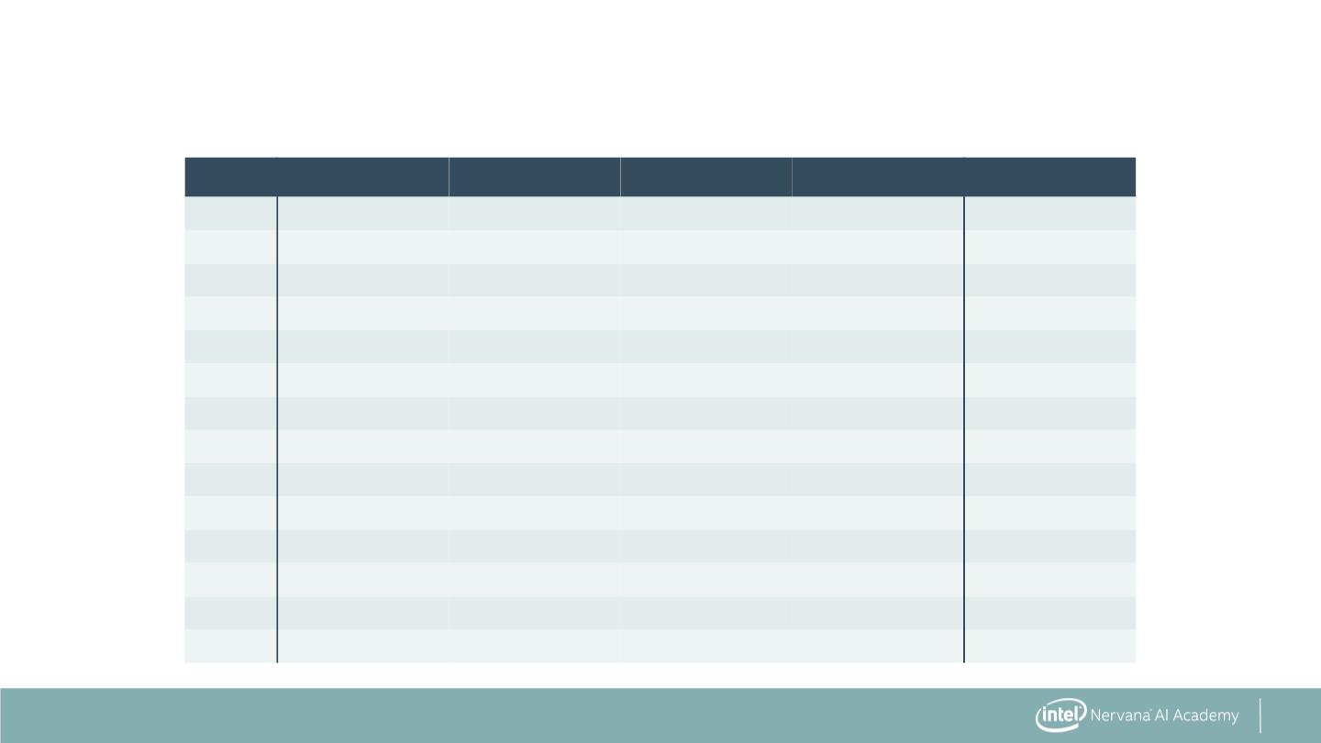
Introduction to Decision Trees
Day
D1
Outlook
Sunny
Sunny
Overcast
Rain
Temperature
Hot
Humidity
High
Wind
Weak
Strong
Weak
Weak
Weak
Strong
Strong
Weak
Weak
Weak
Strong
Strong
Weak
Strong
PlayTennis
No
No
D2
Hot
High
D3
Hot
High
Yes
Yes
Yes
No
D4
Mild
High
D5
Rain
Cool
Cool
Cool
Mild
Normal
Normal
Normal
High
D6
Rain
D7
Overcast
Sunny
Sunny
Rain
Yes
No
D8
D9
Cool
Mild
Normal
Normal
Normal
High
Yes
Yes
Yes
Yes
Yes
No
D10
D11
D12
D13
D14
Sunny
Overcast
Overcast
Rain
Mild
Mild
Hot
Normal
High
Mild
10

Slide 3

Introduction to Decision Trees
▪ Want to predict whether to play
tennis based on temperature,
humidity, wind, outlook
11

Slide 4

Introduction to Decision Trees
▪ Want to predict whether to play
tennis based on temperature,
humidity, wind, outlook
Temperature:
>= Mild
▪ Segment data based on features
to predict result
No Tennis
Play Tennis
12

Slide 5

Introduction to Decision Trees
▪ Want to predict whether to play
tennis based on temperature,
humidity, wind, outlook
Nodes
Temperature:
>= Mild
▪ Segment data based on features
to predict result
No Tennis
Play Tennis
Leaves
13

Slide 6

Introduction to Decision Trees
▪ Want to predict whether to play
tennis based on temperature,
humidity, wind, outlook
Nodes
Temperature:
>= Mild
Humidity:
= Normal
▪ Segment data based on features
to predict result
No Tennis
No Tennis
Leaves
Play Tennis
14

Slide 7
Introduction to Decision Trees
▪ Want to predict whether to play
tennis based on temperature,
humidity, wind, outlook
Nodes
Temperature:
>= Mild
Humidity:
= Normal
▪ Segment data based on features
to predict result
No Tennis
▪ Trees that predict categorical
results are decision trees
No Tennis
Leaves
Play Tennis
15

Slide 8
Regression Trees Predict
Continuous Values
▪ Example: use slope and elevation
in Himalayas
▪ Predict average precipitation
(continuous value)
16

Slide 9

Regression Trees Predict
Continuous Values
Nodes
Elevation:
< 7900 ft.
▪ Example: use slope and elevation
in Himalayas
▪ Predict average precipitation
Slope:
< 2.5º
(continuous value)
55.42 in.
13.67 in.
Leaves
48.50 in.
17

Slide 10
Regression Trees Predict
Continuous Values
Nodes
Elevation:
< 7900 ft.
▪ Example: use slope and elevation
in Himalayas
▪ Predict average precipitation
Slope:
< 2.5º
(continuous value)
55.42 in.
▪ Values at leaves are averages of
members
13.67 in.
Leaves
48.50 in.
18

Slide 11
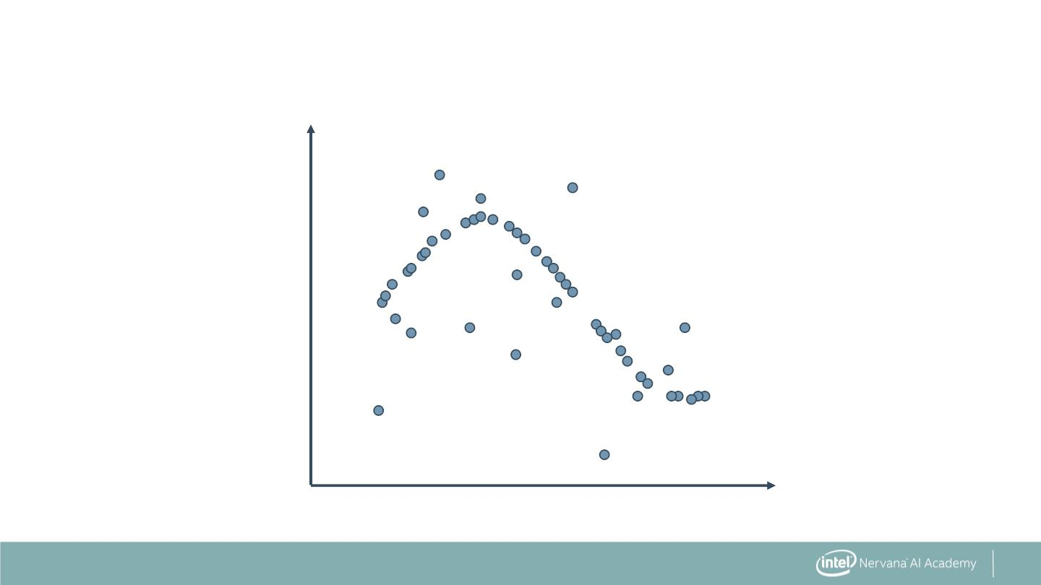
Regression Trees Predict Continuous Values
2.0
1.0
0.0
-1.0
-2.0
0
1
2
3
4
5
Source: http://scikit-learn.org/stable/auto_examples/tree/plot_tree_regression.html
19

Slide 12
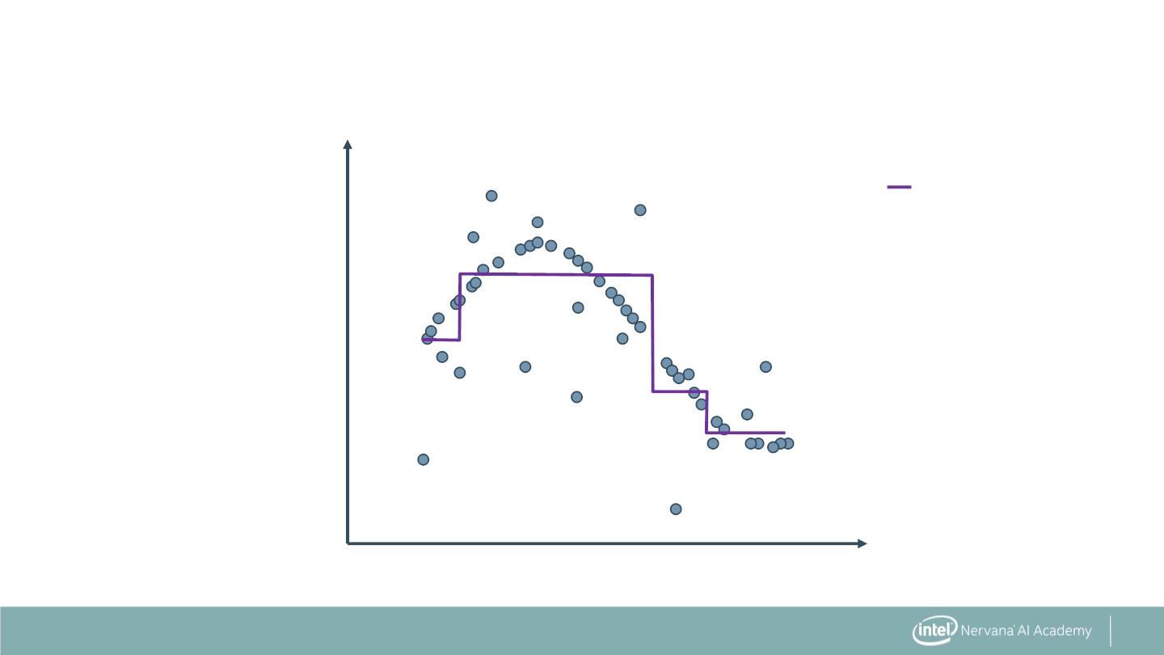
Regression Trees Predict Continuous Values
2.0
max_depth=2
1.0
0.0
-1.0
-2.0
0
1
2
3
4
5
Source: http://scikit-learn.org/stable/auto_examples/tree/plot_tree_regression.html
20

Slide 13
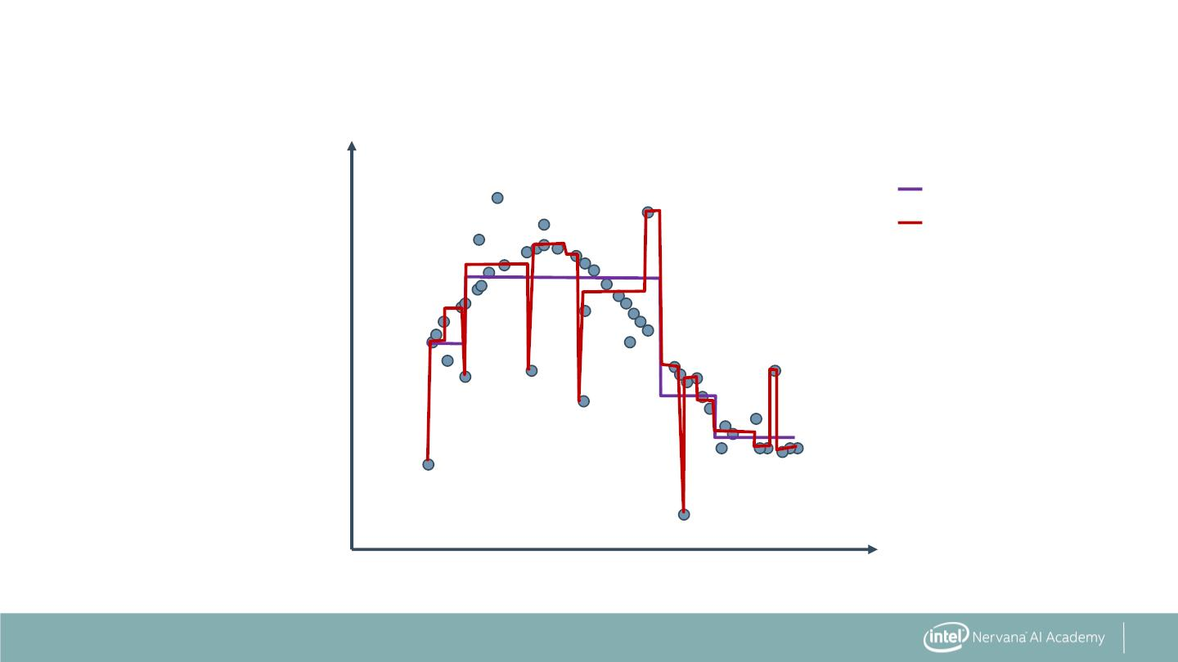
Regression Trees Predict Continuous Values
2.0
max_depth=2
max_depth=5
1.0
0.0
-1.0
-2.0
0
1
2
3
4
5
Source: http://scikit-learn.org/stable/auto_examples/tree/plot_tree_regression.html
21

Slide 14
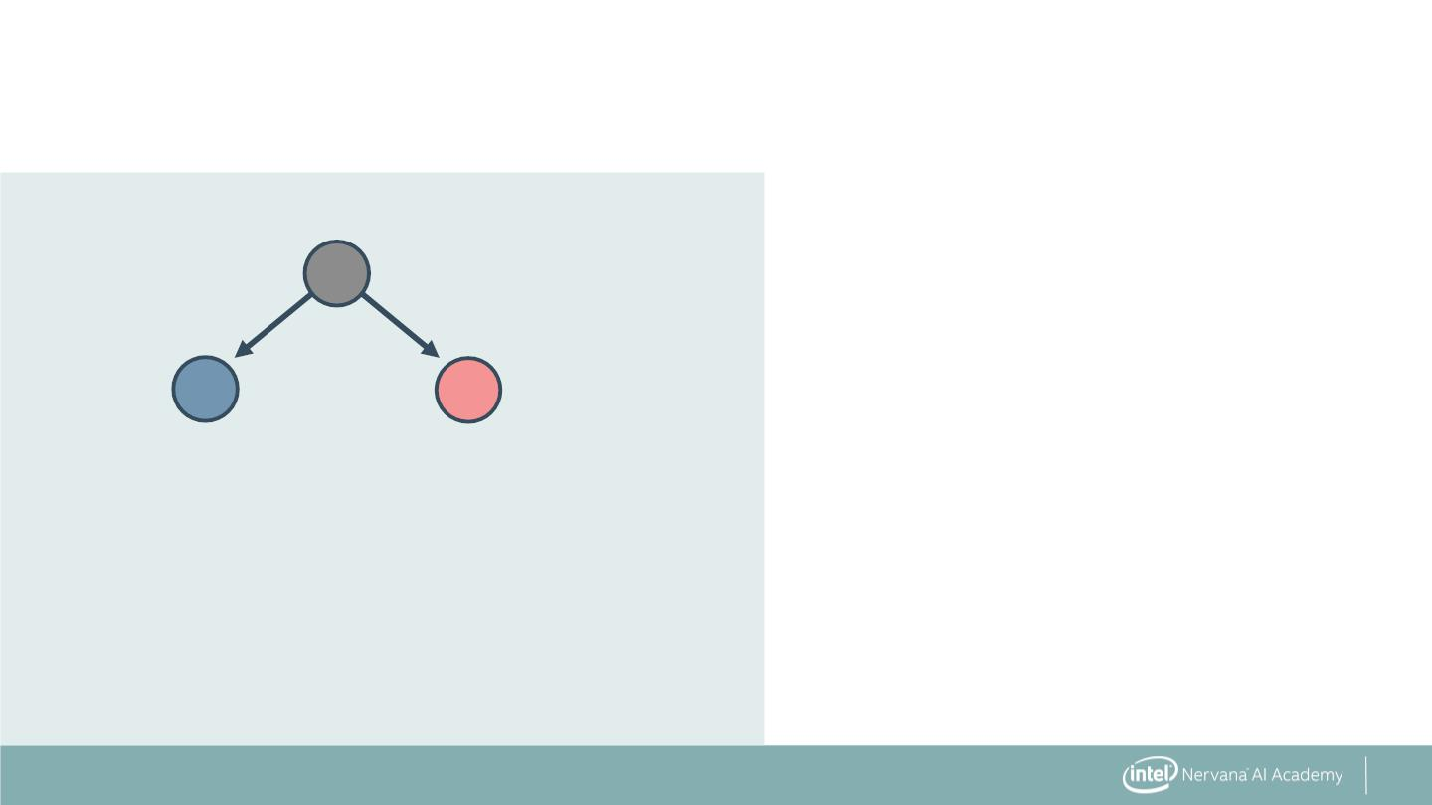
Building a Decision Tree
▪ Select a feature and split data
into binary tree
22

Slide 15
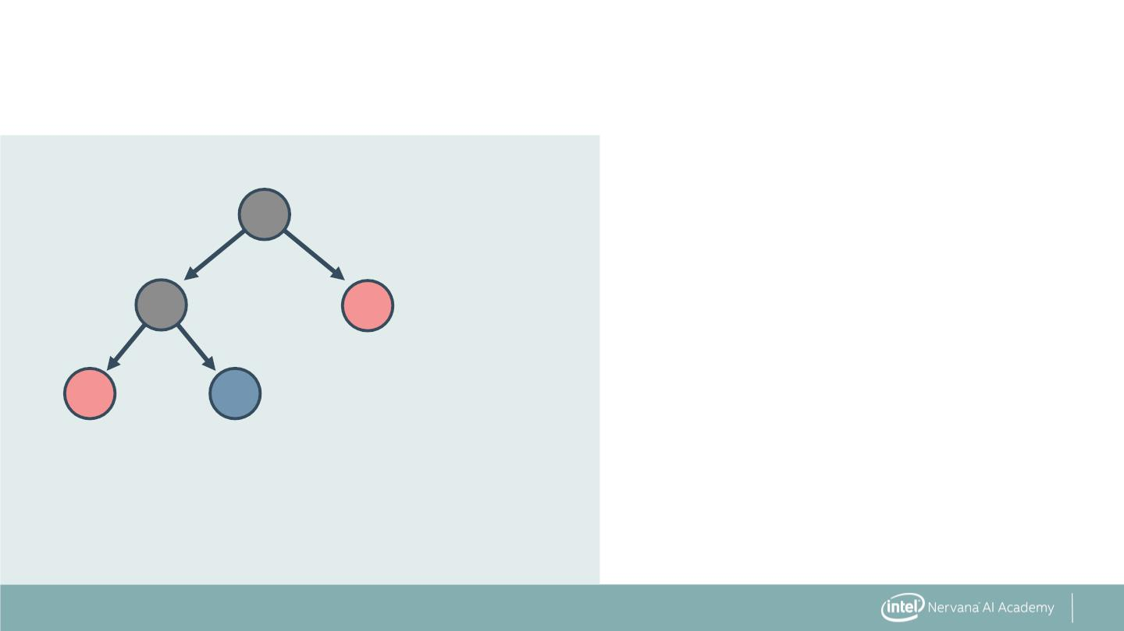
Building a Decision Tree
▪ Select a feature and split data
into binary tree
▪ Continue splitting with
available features
23

Slide 16
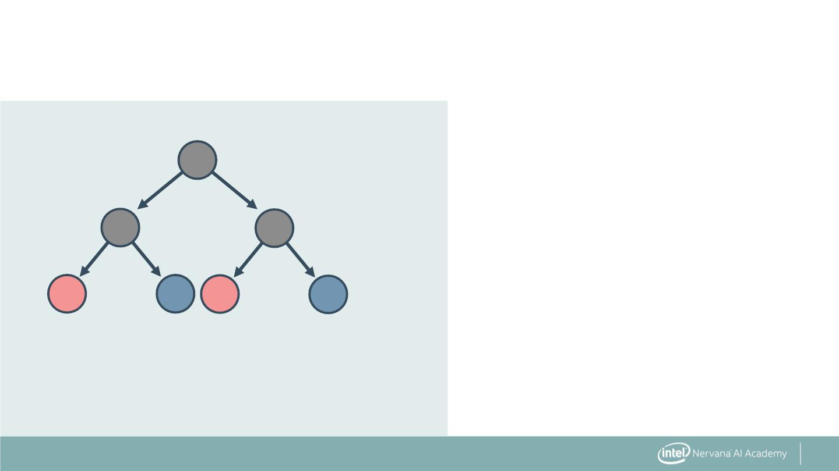
Building a Decision Tree
▪ Select a feature and split data
into binary tree
▪ Continue splitting with
available features
24

Slide 17
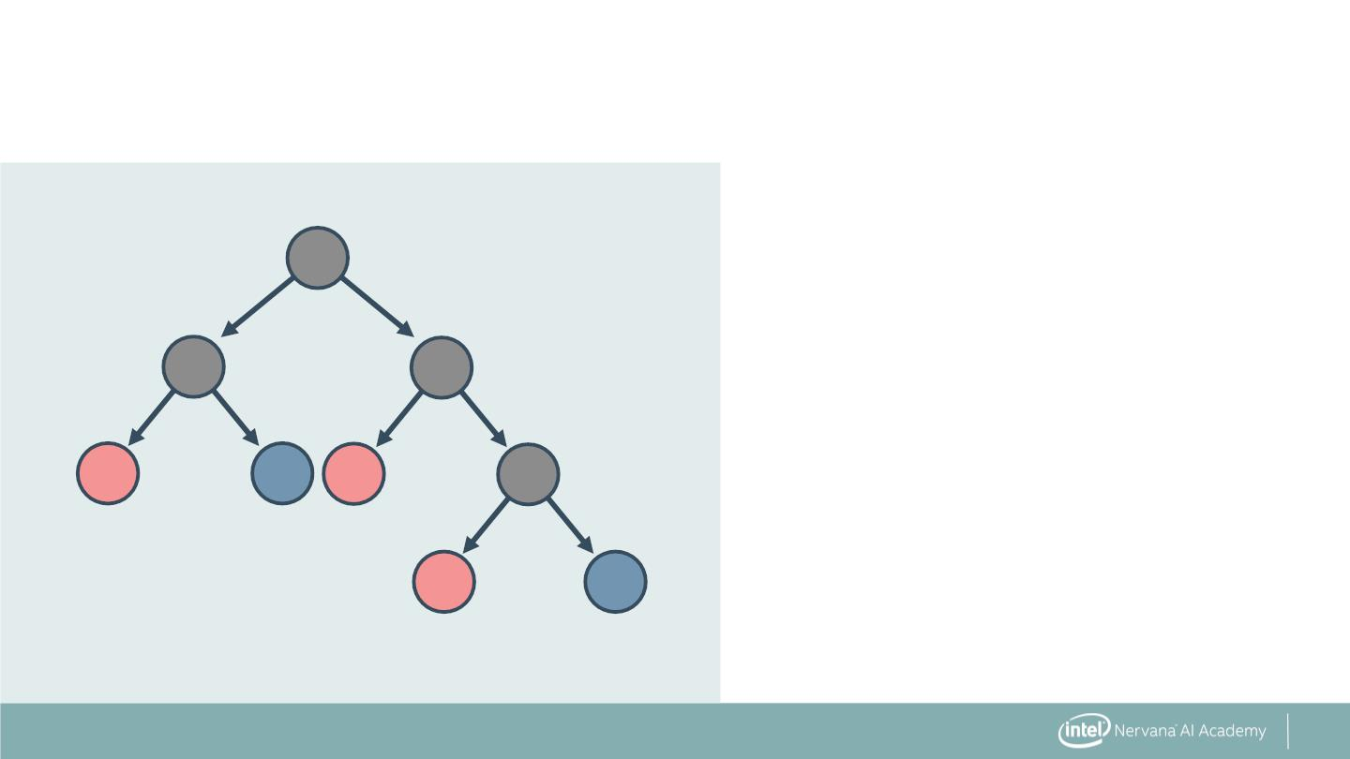
How Long to Keep Splitting?
25

Slide 18
How Long to Keep Splitting?
Until:
▪ Leaf node(s) are pure—only one
class remains
26

Slide 19
How Long to Keep Splitting?
Until:
▪ Leaf node(s) are pure—only one
class remains
▪ A maximum depth is reached
27

Slide 20
How Long to Keep Splitting?
Until:
▪ Leaf node(s) are pure—only one
class remains
▪ A maximum depth is reached
▪ A performance metric is achieved
28

Slide 21
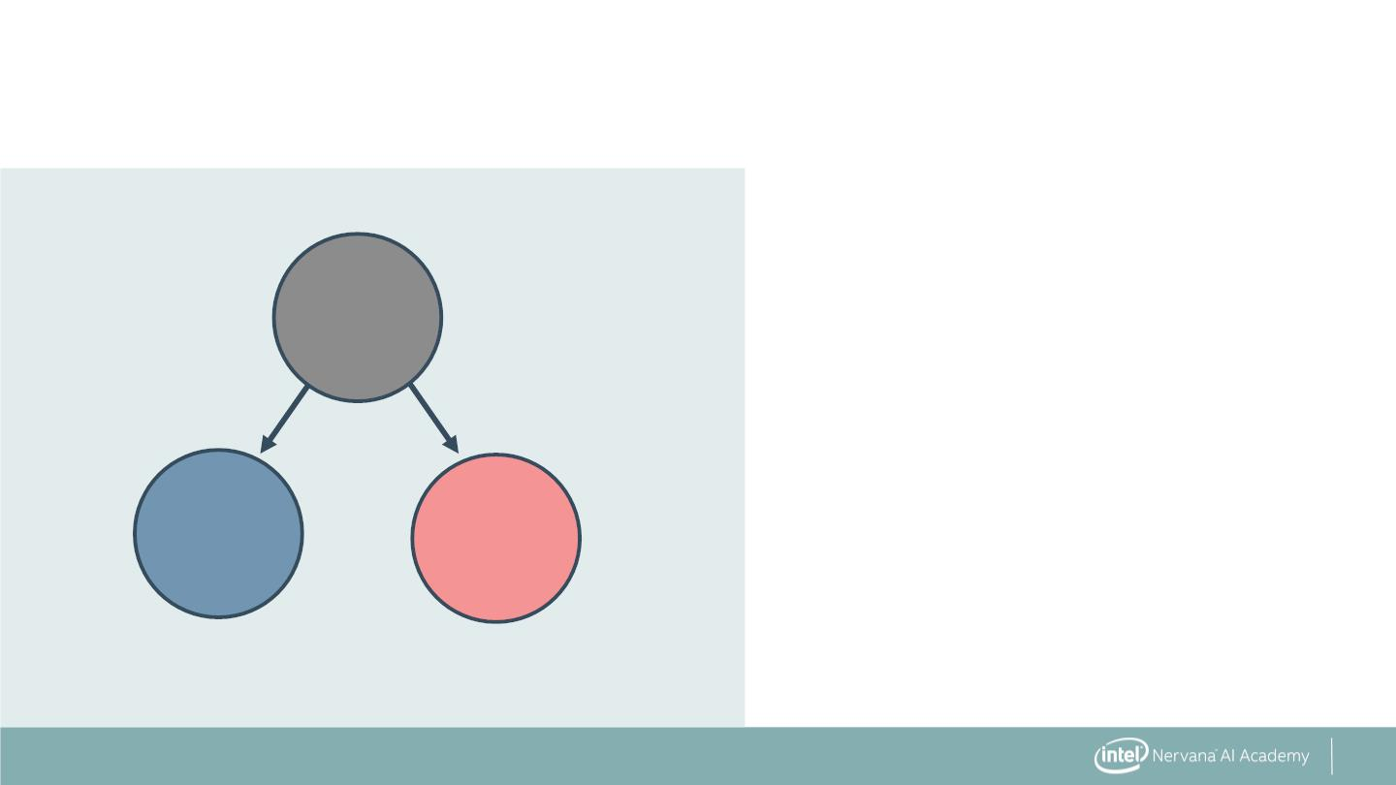
Building the Best Decision Tree
▪ Use greedy search: find the
best split at each step
Temperature:
>= Mild
No Tennis
Play Tennis
Leaves
29

Slide 22
Building the Best Decision Tree
▪ Use greedy search: find the
best split at each step
▪ What defines the best split?
Temperature:
>= Mild
No Tennis
Play Tennis
Leaves
30

Slide 23
Building the Best Decision Tree
▪ Use greedy search: find the
best split at each step
▪ What defines the best split?
Temperature:
>= Mild
▪ One that maximizes the
information gained from
the split
No Tennis
Play Tennis
Leaves
31

Slide 24
Decision Trees are High Variance
▪ Problem: decision trees tend
to overfit
65

Slide 25
Decision Trees are High Variance
▪ Problem: decision trees tend
to overfit
▪ Small changes in data
greatly affect prediction—
high variance
66

Slide 26
Decision Trees are High Variance
▪ Problem: decision trees tend
to overfit
▪ Small changes in data
greatly affect prediction—
high variance
▪ Solution: Prune trees
67

Slide 27
Pruning Decision Trees
▪ Problem: decision trees tend
to overfit
▪ Small changes in data greatly
affect prediction—high
variance
▪ Solution: Prune trees
68

Slide 28
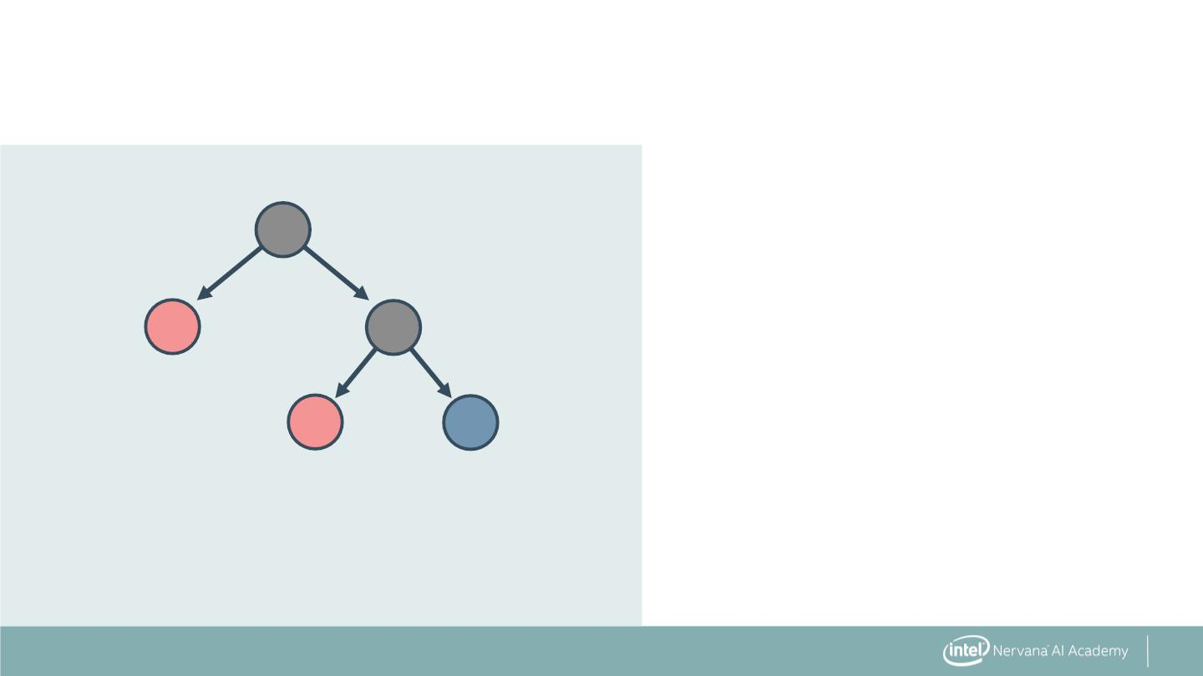
Pruning Decision Trees
▪ Problem: decision trees tend
to overfit
▪ Small changes in data greatly
affect prediction—high
variance
▪ Solution: Prune trees
69

Slide 29
Pruning Decision Trees
▪ How to decide what leaves to
prune?
70

Slide 30
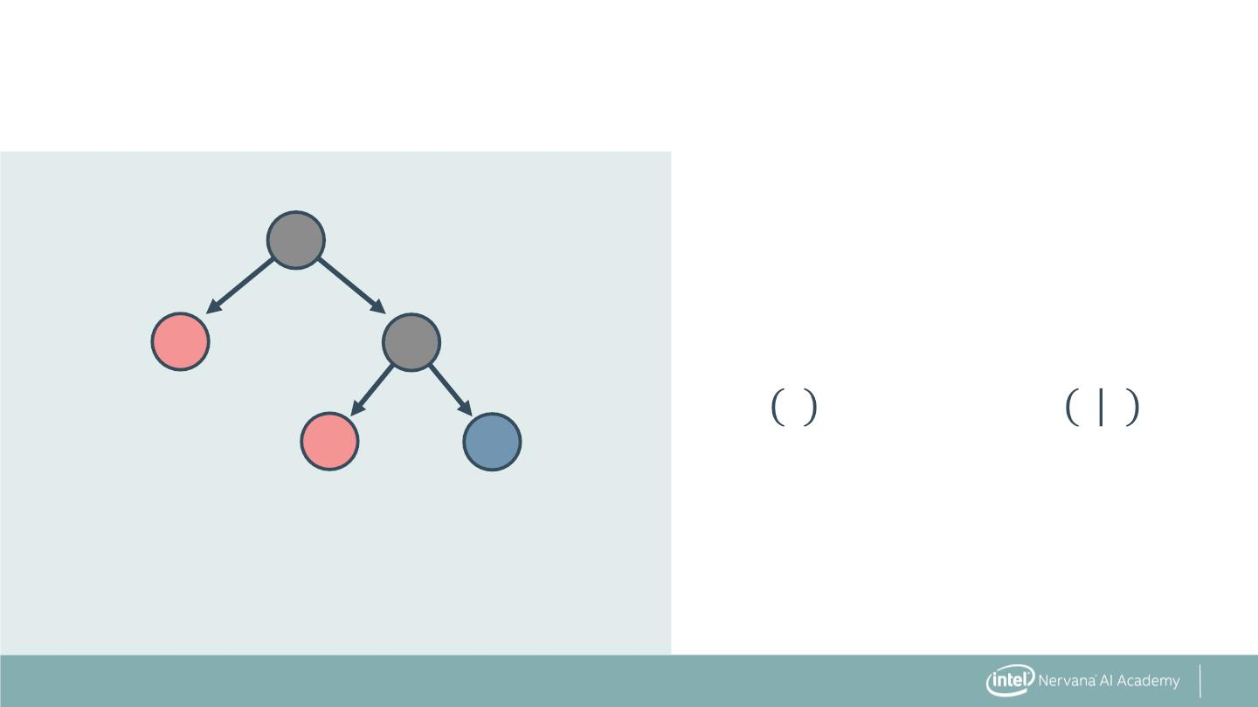
Pruning Decision Trees
▪ How to decide what leaves to
prune?
▪ Solution: prune based on
classification error threshold
푖
71

Slide 31
Strengths of Decision Trees
▪ Easy to interpret and
implement—"if … then …
else" logic
72

Slide 32
Strengths of Decision Trees
▪ Easy to interpret and
implement—"if … then …
else" logic
▪ Handle any data category—
binary, ordinal, continuous
73

Slide 33
Strengths of Decision Trees
▪ Easy to interpret and
implement—"if … then …
else" logic
▪ Handle any data category—
binary, ordinal, continuous
▪ No preprocessing or scaling
required
74

Slide 34

DecisionTreeClassifier: The Syntax
Import the class containing the classification method.
from sklearn.tree import DecisionTreeClassifier
75

Slide 35
DecisionTreeClassifier: The Syntax
Import the class containing the classification method.
from sklearn.tree import DecisionTreeClassifier
Create an instance of the class.
DTC = DecisionTreeClassifier(criterion='gini’,
max_features=10, max_depth=5)
76

Slide 36

DecisionTreeClassifier: The Syntax
Import the class containing the classification method.
from sklearn.tree import DecisionTreeClassifier
Create an instance of the class.
tree
parameters
DTC = DecisionTreeClassifier(criterion='gini’,
max_features=10, max_depth=5)
77

Slide 37
DecisionTreeClassifier: The Syntax
Import the class containing the classification method.
from sklearn.tree import DecisionTreeClassifier
Create an instance of the class.
DTC = DecisionTreeClassifier(criterion='gini’,
max_features=10, max_depth=5)
Fit the instance on the data and then predict the expected value.
DTC = DTC.fit(X_train, y_train)
y_predict = DTC.predict(X_test)
78

Slide 38
DecisionTreeClassifier: The Syntax
Import the class containing the classification method.
from sklearn.tree import DecisionTreeClassifier
Create an instance of the class.
DTC = DecisionTreeClassifier(criterion='gini’,
max_features=10, max_depth=5)
Fit the instance on the data and then predict the expected value.
DTC = DTC.fit(X_train, y_train)
y_predict = DTC.predict(X_test)
Tune parameters with cross-validation. Use DecisionTreeRegressor for
regression.
79

Slide 39


